Slide 1

Interpolation
Lagrange interpolation
不正经讲师：理科宅Hunt

Slide 2
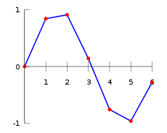
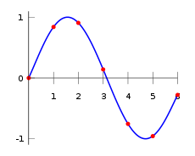
Interpolation – 什么是插值？
Data points are given
An interpolant is a function(usually polynomial) that goes through all given data points.
应用：连接（动画、音频）关键帧
Linear interpolation
Spline interpolation

Slide 3
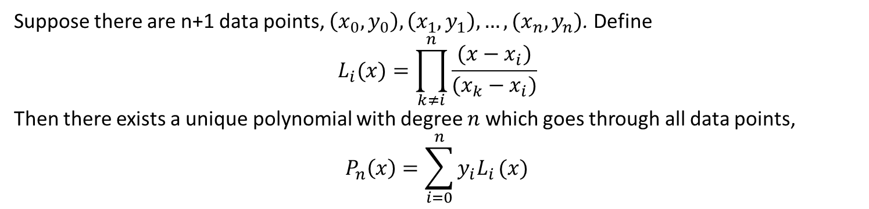
Lagrange interpolation – 拉格朗日插值法
Suppose there are n+1 data points, $\left(x_{0},y_{0}\right),\left(x_{1},y_{1}\right),…, (x_{n}, y_{n})$. Define
$$L_{i}(x)=\prod_{k≠i}^{n}{\frac{(x−x_{i})}{(x_{k}−x_{i})}}$$
Then there exists a unique polynomial with degree $n$ which goes through all data points,
$$P_{n}\left(x\right)=\sum_{i=0}^{n}{y_{i}L_{i}}(x)$$

Slide 4
Example – 举个栗子
Ex. Given 3 data points $\left(0,0\right), \left(1,1\right), (2,0)$, find the Lagrange polynomial.

Slide 5
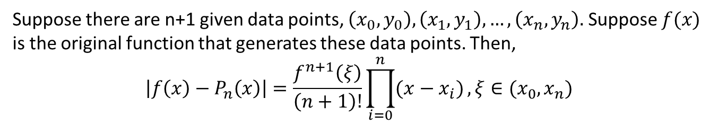
Accuracy (Error bound) – 准确度
Suppose there are n+1 given data points, $\left(x_{0},y_{0}\right), \left(x_{1},y_{1}\right),…, \left(x_{n},y_{n}\right).$ Suppose $f(x)$ is the original function that generates these data points. Then,
$$\left|f\left(x\right)−P_{n}\left(x\right)\right|=\frac{f^{n+1}\left(ξ\right)}{\left(n+1\right)!}\prod_{i=0}^{n}{(x−x_{i})}, ξ∈(x_{0},x_{n})$$

Slide 6
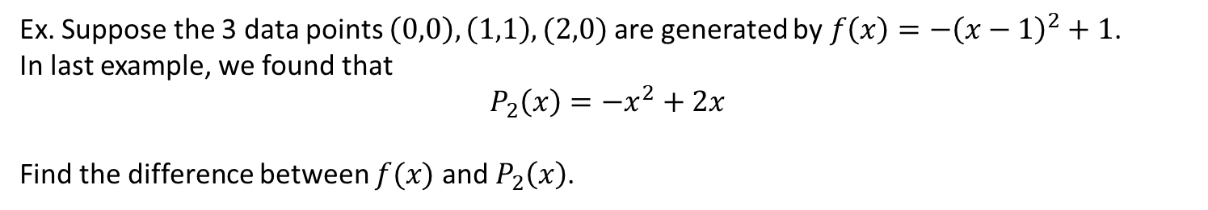
Example – 举个栗子
Ex. Suppose the 3 data points $\left(0,0\right), \left(1,1\right), (2,0)$ are generated by $f\left(x\right)=−{\left(x−1\right)}^{2}+1$.
In last example, we found that
$$P_{2}\left(x\right)=−x^{2}+2x$$
Find the difference between $f(x)$ and $P_{2}\left(x\right)$.

Slide 7


Cost (construct polynomial) – 构建多项式的花费
Suppose there are n+1 data points, $\left(x_{0},y_{0}\right),\left(x_{1},y_{1}\right),…, (x_{n}, y_{n})$. It takes $O(n^{2})$ to construct the polynomial
$$L_{i}(x)=\prod_{k≠i}^{n}{\frac{(x−x_{i})}{(x_{k}−x_{i})}}$$
$$P_{n}\left(x\right)=\sum_{i=0}^{n}{y_{i}L_{i}}(x)$$

Slide 8
Cost (evaluation) – 多项式求值的花费
Suppose there are n+1 data points, $\left(x_{0},y_{0}\right),\left(x_{1},y_{1}\right),…, (x_{n}, y_{n})$. It takes $O(n^{2})$ to evaluate the polynomial
$$L_{i}(x)=\prod_{k≠i}^{n}{\frac{(x−x_{i})}{(x_{k}−x_{i})}}$$
$$P_{n}\left(x\right)=\sum_{i=0}^{n}{y_{i}L_{i}}(x)$$

Slide 9
Cost (add 1 more node) – 增加1个数据点的花费
Suppose there are n+1 data points, $\left(x_{0},y_{0}\right),\left(x_{1},y_{1}\right),…, (x_{n}, y_{n})$. It takes $O(n^{2})$ to reconstruct the polynomial
$$L_{i}(x)=\prod_{k≠i}^{n}{\frac{(x−x_{i})}{(x_{k}−x_{i})}}$$
$$P_{n}\left(x\right)=\sum_{i=0}^{n}{y_{i}L_{i}}(x)$$

Slide 10
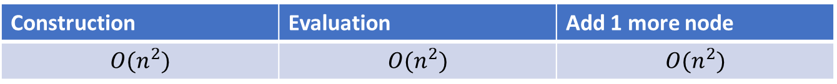
Conclusion – 总结
学到了Lagrange interpolation跟动画之间的关系
穿过n+1个数据点的最高次数为n的多项式有且只有1条
Lagrange interpolation的计算花费颇高，之后会有改良
Construction | Evaluation | Add 1 more node
$$O(n^{2})$$ | $$O(n^{2})$$ | $$O(n^{2})$$

